Slide 1



LOWELL GENERAL HOSPITAL PROJECT
This project analyzes key insights from Lowell General Hospital, a facility that prioritizes patient well-being above all else. Management has identified multiple factors that could contribute to patient dissatisfaction and has initiated an analysis of the following key metrics to ensure optimal patient care and uphold its reputation for excellence:
1. Average Licensed Bed Occupancy Rate
2. Staff Responsiveness Top Box Score
3. Unassisted Patient Falls per 1000 Patient Days
This internally captured measure is expressed as a percentage: (Number of patients in licensed beds per day * 100) / Number of licensed beds. It reflects the utilization of hospital resources.
Derived from the HCAHPS Survey, this score assesses patient perception of prompt assistance with call buttons and bathroom needs. It measures the percentage of patients answering "Always" to key questions regarding staff responsiveness.
Captured by the NDNQI, this metric tracks unplanned patient descents without staff assistance. It is measured as: (Number of patient falls * 1000) / Number of patient days, highlighting patient safety outcomes.

Slide 2
Dataset Provided
Month
Average Licensed Bed Occupancy Rate
Unassisted Fall Rate per 1,000 Patient Days
Staff Responsiveness Domain Top Box Score
Unassisted Fall %
Staff Responsiveness Domain Top Box Score %
Staff Responsiveness Top Box Score Benchmark
Jan-20
96%
2.21
68.34
0.221
0.6834
65
Feb-20
96%
1.79
72.75
0.179
0.7275
65
Mar-20
81%
1.03
67.07
0.103
0.6707
65
Apr-20
94%
1.97
71.21
0.197
0.7121
65
May-20
101%
3.41
57.68
0.341
0.5768
65
Jun-20
98%
2.61
67.86
0.261
0.6786
65
Jul-20
95%
2.42
66.09
0.242
0.6609
65
Aug-20
94%
2.09
70.38
0.209
0.7038
65
Sep-20
95%
3.11
53.31
0.311
0.5331
65
Oct-20
92%
1.6
67.55
0.16
0.6755
65
Nov-20
95%
2.31
60.35
0.231
0.6035
65
Dec-20
98%
2.47
61.33
0.247
0.6133
65
Jan-21
100%
3.03
61.06
0.303
0.6106
65
Feb-21
99%
2.35
65.23
0.235
0.6523
65
Mar-21
95%
2.47
64.02
0.247
0.6402
65
Apr-21
96%
1.94
70.11
0.194
0.7011
65
May-21
94%
2.54
68.16
0.254
0.6816
65

Slide 3

Metrics Analysis: 2020-2024 Trends
A detailed examination of key performance indicators reveals significant trends in hospital operations and patient care over the past five years.
Average Licensed Bed Occupancy Rate
Staff Responsiveness Domain Top Box Score Percentage
Average Unassisted Patient Fall Rate per 1000 Patient Days
In 2020, the average occupancy rate stood at 94.5%, with monthly fluctuations (e.g., a peak of 101% in May 2020 and a low of 81% in March 2020).
The average score for staff responsiveness in 2020 was 65.4%, demonstrating strong patient satisfaction early on.
The average unassisted patient fall rate in 2020 was 2.26 per 1000 patient days, reflecting initial safety performance.
This rate saw an increase, averaging 2.75 in 2022 and peaking slightly at 2.82 in 2023, which may correlate with increased occupancy or other operational changes.
This rate remained consistently high, averaging 95.8% in 2021 and showing a slight increase to 97.2% in 2022.
However, this metric saw a decline to 61.2% in 2022, suggesting a period of reduced patient perception of prompt assistance.
The trend continued upward, reaching 97.5% in 2023 and stabilizing at 97.0% in 2024, indicating sustained high utilization of hospital resources and licensed beds.
Encouragingly, the rate decreased to an average of 2.60 in 2024, suggesting that recent safety initiatives have begun to mitigate fall risks, though further prevention efforts are warranted.
Following targeted interventions, scores showed a positive recovery, improving to 63.5% in 2023 and reaching 64.1% in 2024, indicating that efforts to enhance staff responsiveness are yielding results but require continued attention to reach previous benchmarks.

Slide 4
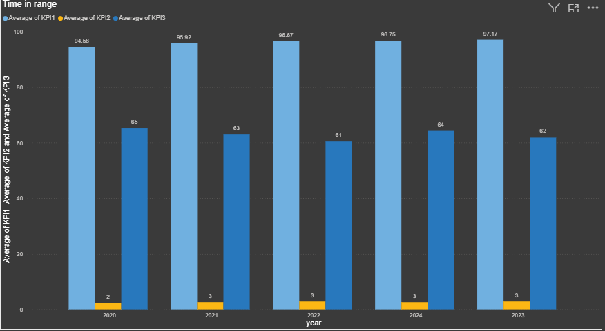
Time in Range

Slide 5



Co-relation between KPIs
Understanding the relationships between key performance indicators is crucial for identifying areas of impact and optimizing hospital operations. The correlation coefficients reveal how changes in one metric tend to coincide with changes in another.
Occupancy Rate & Unassisted Falls
A notable positive correlation of 0.70 suggests that as the average licensed bed occupancy rate increases, there is a tendency for unassisted patient fall rates to also rise. This indicates that higher patient volumes may stretch resources, potentially affecting patient safety.
Occupancy Rate & Staff Responsiveness
A negative correlation of -0.37 implies that as bed occupancy increases, staff responsiveness tends to slightly decrease. This weaker inverse relationship might suggest that higher patient loads can marginally impact the perceived promptness of staff assistance.
Unassisted Falls & Staff Responsiveness
A strong negative correlation of -0.79 highlights a significant inverse relationship. When staff responsiveness scores are lower, the rate of unassisted patient falls tends to be higher. This strongly suggests that prompt staff attention is a critical factor in preventing patient falls.

Slide 6
Dashboard

Slide 7
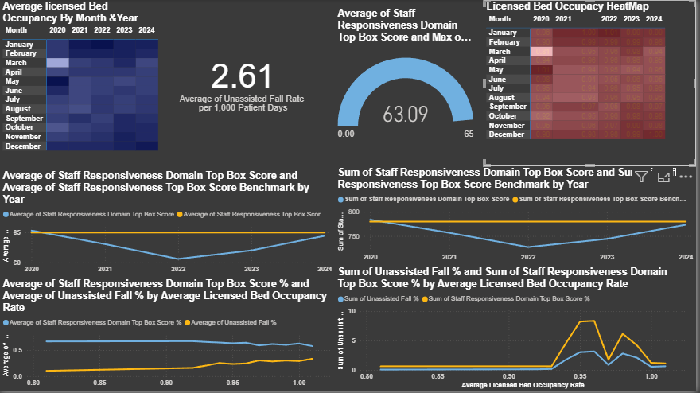
Dataset power BI Report

Slide 8
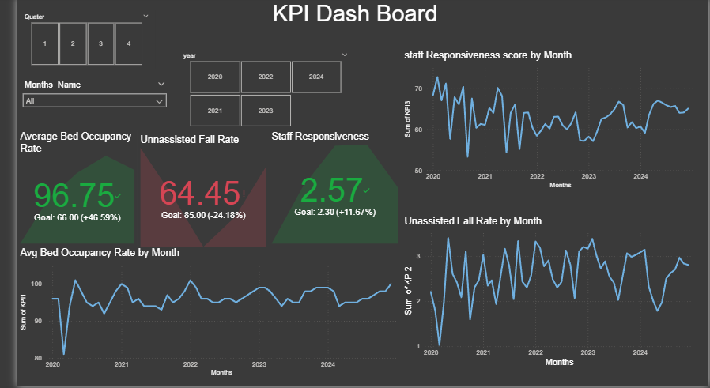

Slide 9
Summary of the Project
Project Objective: This project comprehensively analyzed key performance indicators at Lowell General Hospital from 2020-2024 to identify critical trends and interdependencies affecting quality of care and operational efficiency. The analysis focused on three core metrics to provide actionable insights for continuous improvement.
Key Findings:
Average Bed Occupancy Rate: The hospital consistently operated at high capacity, with occupancy rates rising from 94.5% in 2020 to peak at 97.5% in 2023, stabilizing around 97.0% in 2024. This sustained high utilization underscores the need for optimized resource management.
Staff Responsiveness Domain Top Box Score: Patient perception of staff responsiveness, initially strong at 65.4% in 2020, experienced a decline to 61.2% by 2022. Encouragingly, targeted initiatives led to a recovery, reaching 64.1% in 2024, nearing the initial benchmark of 65%.
Unassisted Patient Fall Rate per 1000 Patient Days: The average fall rate increased from 2.26 in 2020 to a peak of 2.82 in 2023. However, recent safety efforts have shown positive results, bringing the rate down to 2.60 in 2024.
Co-relation between KPIs:
A significant positive correlation of 0.70 was observed between the Average Licensed Bed Occupancy Rate and Unassisted Patient Fall Rate, indicating that higher patient volumes likely strain resources and increase fall risk.
A strong negative correlation of -0.79 between Staff Responsiveness and Unassisted Patient Fall Rate highlights that improved staff attention directly contributes to fall prevention.
A negative correlation of -0.37 between Occupancy Rate and Staff Responsiveness suggests that increased patient load can marginally impact perceived staff promptness.
Key Insights & Recommendations:
Optimize Staff-Patient Ratios: Given the strong positive correlation between occupancy and falls, and the negative correlation between responsiveness and falls, dynamically adjusting staff levels based on real-time bed occupancy is crucial. This proactive approach can enhance patient safety and staff availability during peak times.
Targeted Staff Training & Protocols: Implement enhanced training programs focusing on prompt patient assistance, effective communication, and advanced fall prevention protocols, especially during periods of high patient volume. Regular drills and performance reviews can reinforce these critical behaviors.
Data-Driven Operational Efficiency: Utilize real-time data from all three KPIs to make informed decisions regarding resource allocation, staffing adjustments, and operational workflows. This allows for continuous adaptation to patient demands while maintaining high standards of care.
Continuous Monitoring & Evaluation: Regularly monitor these key metrics and their correlations to identify emerging trends and assess the effectiveness of implemented interventions. Establishing clear benchmarks and quarterly reviews will ensure sustained improvement.
Conclusion: Maintaining an optimal balance between high bed occupancy and exceptional patient care is achievable through data-informed strategies. Lowell General Hospital can further enhance patient safety and overall performance by prioritizing dynamic staffing models, continuous staff training, and leveraging KPI correlations for strategic decision-making.

Slide 10
THANK YOU!! Santosh seru

